Slide 1
CitiBike Ridership Analysis
2025
Cameron Jones
Analyzing NYC CitiBike rider data from Lyft to uncover demand patterns for bikeshare planning.

Slide 2
Cameron Jones 2025
DATA & TOOLS USED:
DATASET:
Citibike August 2025 Data (~1M rides)
TOOLS:
SQL (data wrangling), Python (visualization)
FEATURES:
start time, end time, station, user type

Slide 3
Cameron Jones 2025
KEY QUESTIONS:
01
WHAT DAYS OF THE WEEK SEE THE MOST RIDERSHIP?
02
WHAT HOURS OF THE DAY ARE THE BUSIEST?
03
WHICH STATIONS SEE THE MOST RIDERS?
04
HOW DOES RIDERSHIP DIFFER FROM CASUAL VS. MEMBER RIDERS?

Slide 4
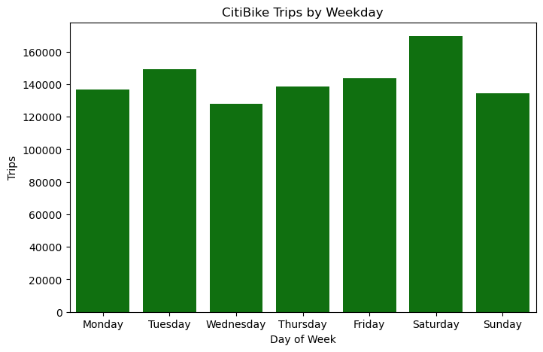
Cameron Jones 2025
01: WHAT DAYS OF THE WEEK SEE THE MOST RIDERSHIP?
Here we see that ridership doesn’t differ significantly day-to-day, however there is a slight peak in ridership on Saturdays.
While the exact cause of the Saturday peak is uncertain, it likely reflects increased leisure riding on days when most people are off work. This suggests CitiBike serves both recreational and practical purposes: weekday usage remains steady for commuting, while leisure riders drive the slight weekend increase.

Slide 5
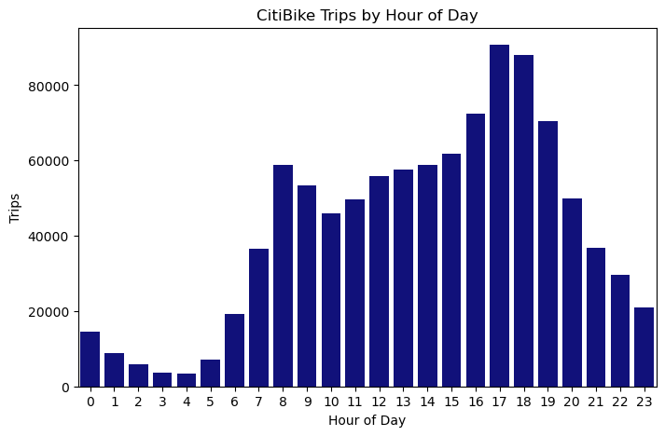
Cameron Jones 2025
02: WHAT HOURS OF THE DAY ARE THE BUSIEST?
Here we see that there is a slight peak in usage between 8:00-9:00 AM, and then a large peak in usage from 4:00-7:00 PM, with the max usage occurring at 5:00 PM.
Based on this, we can assume that the peaks in ridership during the morning and evening hours are due to people biking to and from work. The consistent usage throughout the rest of the day likely comes from tourists and leisure riders, also showing that CitiBike is used both as a practical commuting option and as a leisure activity.

Slide 6
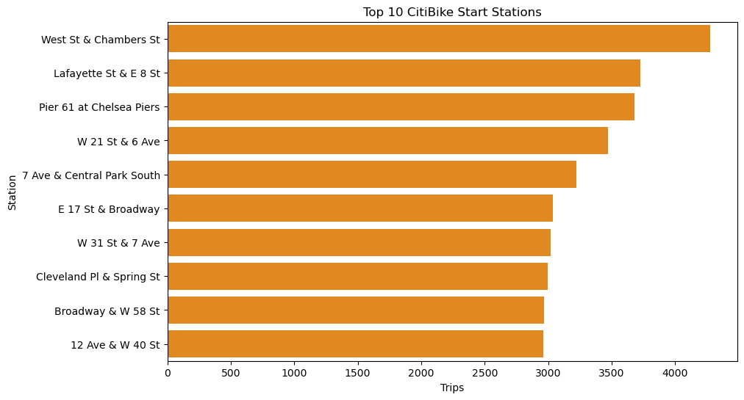
Cameron Jones 2025
03: WHICH STATIONS SEE THE MOST RIDERS?
Here we see the station that sees the most riders is the West St & Chambers St station. This station is in the lead by about 700 riders, while the ones below all fall between 3000 and 3500 riders.
The leading station near the World Trade Center and Financial District reinforces CitiBike’s role for commuters. Other top stations in the East Village/SoHo, Hudson Yards/Chelsea, and Columbus Circle/Central Park suggest a mix of student commuters, office workers, and tourists biking along the piers or through the park.

Slide 7
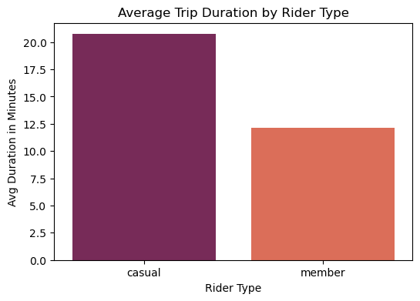
Cameron Jones 2025
04: HOW DOES RIDERSHIP DIFFER FROM CASUAL VS MEMBER RIDERS?
Here we see that casual riders tend to have longer trips on average than membership riders.
From this, we can assume that members tend to take more frequent, shorter trips, reflecting routine commuting or quick point-to-point travel. Casual riders, on the other hand, often take longer trips, likely for one-time sightseeing or leisure purposes.

Slide 8
Cameron Jones 2025
FINAL INSIGHTS:
USAGE PATTERNS:
OPERATIONAL NEEDS:
Weekday rush-hour peaks show that CitiBike is a reliable commuter option
Midday and weekend activity shows consistent recreational and leisure use.
RIDER MIX:
Bikes should be reallocated to high-demand commuter hubs during evening rush hours.
Weekend rebalancing should prioritize tourist heavy stations.
STRATEGIC OPPORTUNITIES:
Stations in business/financial districts serve mostly commuters.
Stations in tourist and campus areas serve mostly casual riders, students, and visitors.
Introduce pricing/membership tiers for commuters vs casual riders.
Promote leisure focused campaigns during weekends (ex. tourist passes)
Partner with businesses near high-demand stations for targeted marketing.

Slide 9
Cameron Jones 2025
THANK YOU

